Slide 1

Unit 8 - Lesson 4
The Limits of Algorithms

Slide 2
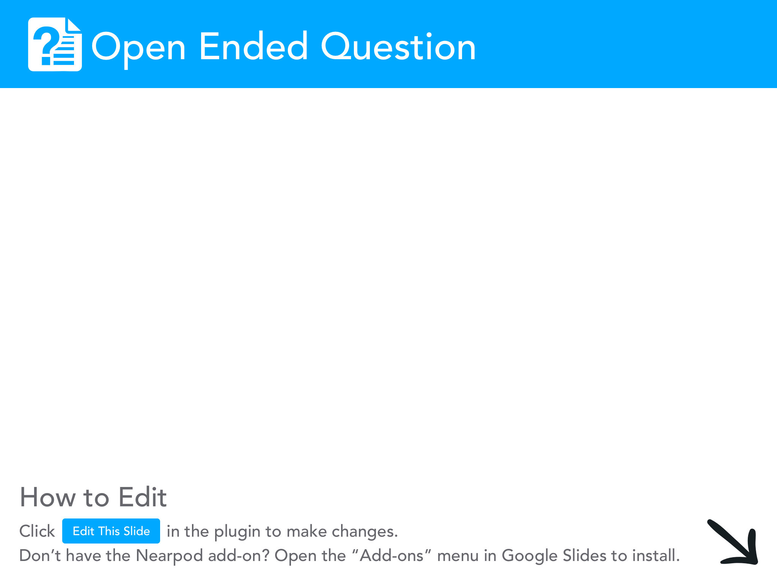
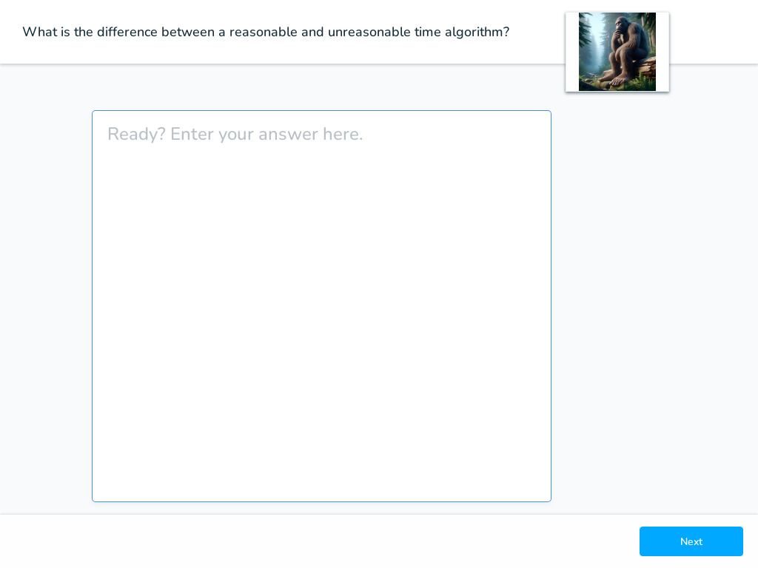

Slide 3

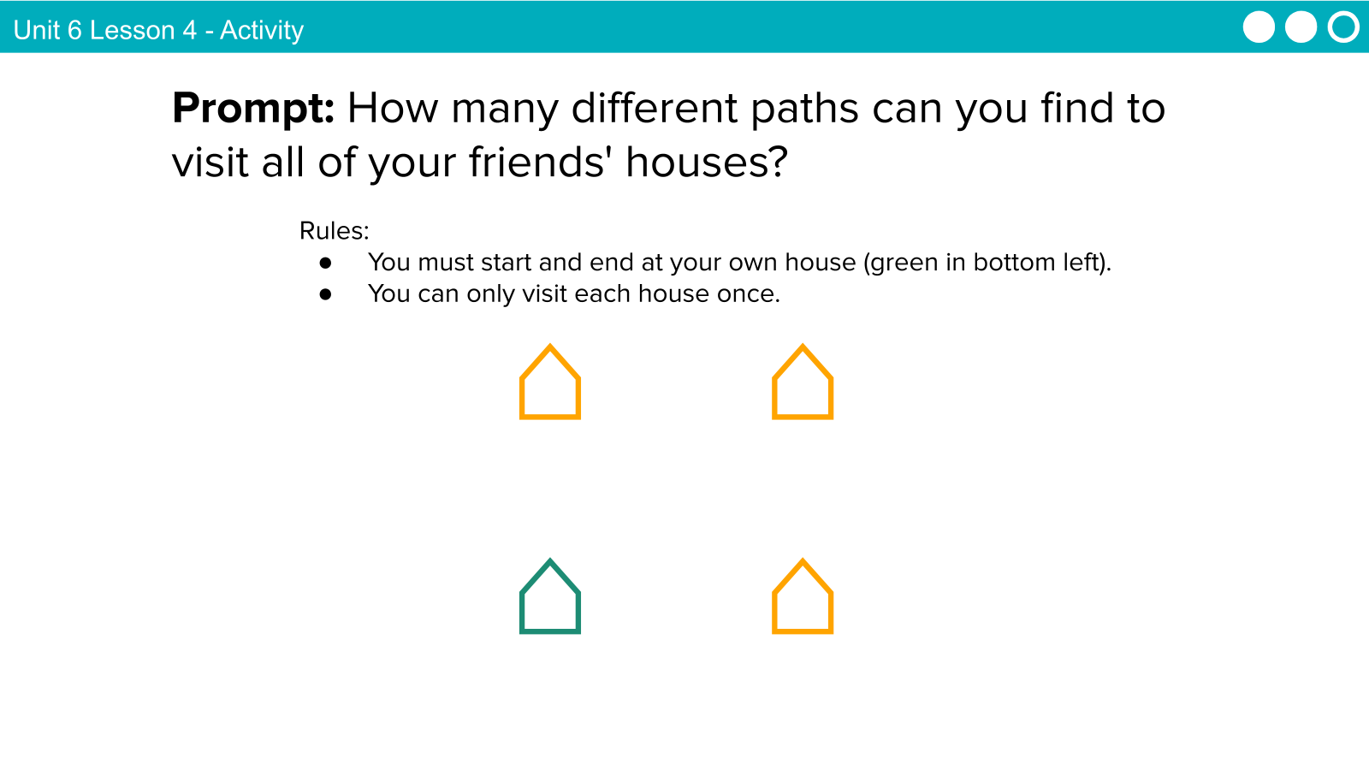

Slide 4

Unit 8 Lesson 4 - Activity
⌂
⌂
⌂
⌂
⌂
⌂
⌂
⌂
⌂
⌂
⌂
⌂
Here are a few different paths you might take.
Prompt:
What do you need to know to determine the best path?

Slide 5
Unit 8 Lesson 4 - Activity
⌂
⌂
⌂
⌂
⌂
⌂
1
1
2
1
1
2
2
1
⌂
⌂
⌂
⌂
⌂
⌂
1
2
1
1
Total: 4
Total: 6
Total: 6
Distance!

Slide 6
Unit 8 Lesson 4 - Activity
Prompt: What if we had a lot more places to visit? How would we determine the best path?
⌂
⌂
⌂
⌂
⌂
⌂
⌂
⌂
⌂
⌂
⌂
⌂
⌂
⌂
⌂
⌂
⌂
⌂
⌂
⌂

Slide 7
Unit 8 Lesson 4 - Activity
This is known as the Traveling Salesman Problem.
For every new place to visit, the number of options for possible paths increases factorialy.
Number of houses to visit | Number of steps to check for the "best" path
1 | 1
2 | 2
3 | 6
4 | 24
5 | 120
6 | 720
7 | 5,040
8 | 40,320
9 | 362,880
10 | 3,628,800

Slide 8
Unit 8 Lesson 4 - Activity
Factorial fun: n!
Number of houses to visit | Number of steps to check for the "best" path
1 | 1
2 | 2
3 | 6
4 | 24
5 | 120
6 | 720
7 | 5,040
8 | 40,320
9 | 362,880
10 | 3,628,800
Here's how n! works:
Multiply all whole numbers from the given number down to the number 1.
For example:
Instance: 4 houses to visit
4 x 3 x 2 x 1 = 24
Instance: 7 houses to visit
7 x 6 x 5 x 4 x 3 x 2 x 1 = 5,040
That's a lot of possible paths to check for only 10 houses!

Slide 9

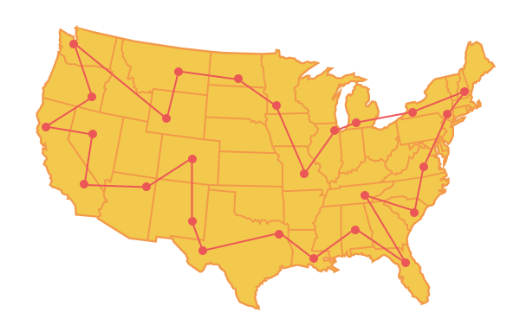
Unit 8 Lesson 4 - Activity
Problems
Any task that may (or may not) be solved with an algorithm.
Sorting a list is a problem. Sorting the list (2, 3, 1, 7) is an instance of that problem.
Two types of problems:
Decision Problems
“Is there a path?”
Optimization Problems
“What’s the shortest path”?

Slide 10
Unit 8 Lesson 4 - Activity
The Traveling Salesman Problem can be solved with an algorithm, which checks each possible option.
BUT, it would take massive amounts of computing power to compare every single option, especially as the number of homes to visit (otherwise known as nodes) increases.
Therefore, it would take an unreasonable amount of time for the solution to be calculated for most instances of the problem.

Slide 11
Unit 8 Lesson 4 - Activity
Welcome to heuristics!
Provide a "good enough" solution to a problem when an actual solution is impractical or impossible

Slide 12
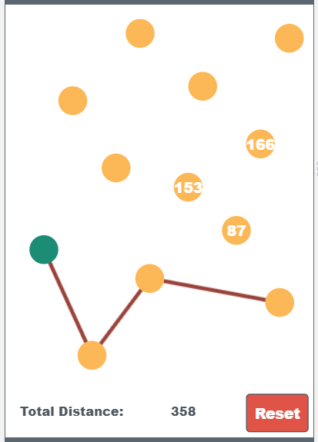
Unit 8 Lesson 4 - Activity
Do This:
Navigate to Level 1 on Code Studio
Try to find the "best" path to visit all nodes.
Write down a plan or heuristic for choosing a good path.
Note: your heuristic may not always find the best path, but it should be close enough

Slide 13
Unit 8 Lesson 4 - Activity
Do This:
Navigate to Level 2 on Code Studio
Test your heuristic on three different levels.
Write down the distance for the path your heuristic finds.
Try to find the best version not using the heuristic (brute force). Can you find a better path? Is your heuristic on average pretty good? Should you update your heuristic?
Distance (Heuristic) | Distance (Brute Force)
1225 | 1215

Slide 14
Unit 8 Lesson 4 - Activity
Prompt:
How did you create your heuristic?
Did you change your heuristic after testing it out?

Slide 15
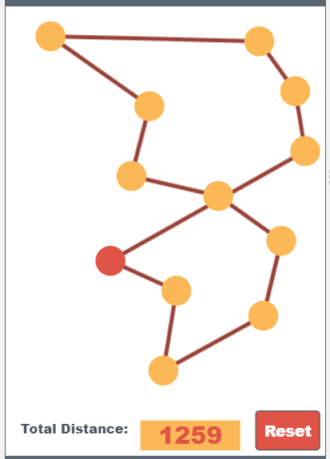
Unit 8 Lesson 4 - Activity
Sample Heuristic:
At each node, travel to the next closest node
Is this "good enough"?
9
10
8
11
7
12
6
5
1
4
2
3

Slide 16
Unit 8 Lesson 4 - Activity
Takeaways:
The Traveling Salesman Problem is an optimization problem. We are attempting to find the best path.
It is also unreasonable because there is not an algorithm that can solve the problem in a reasonable amount of time.
We need to use a heuristic to come up with a solution that is "good enough" for most instances of the problem.

Slide 17
Unit 8 Lesson 4 - Activity
Problems
Any task that may (or may not) be solved with an algorithm.
Sorting a list is a problem. Sorting the list (2, 3, 1, 7) is an instance of that problem.
Decision Problems
“Is there a path?”
Optimization Problems
“What’s the shortest path”?
Undecidable Problems
“Will this code work?”

Slide 18
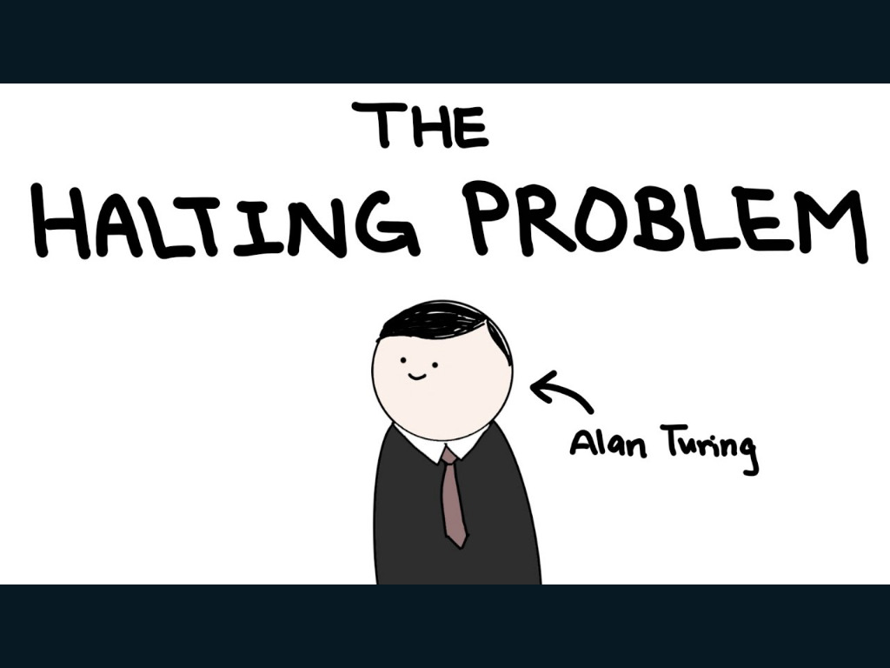


Slide 19
Unit 8 Lesson 4 - Activity
Takeaways:
There are some problems we’ve proven that no computer will ever be able to solve. The Halting Problem is a very famous example and in general we call these problems undecidable.

Slide 20

Unit 8 Lesson 4 - Wrap Up
Heuristic: provides a "good enough" solution to a problem when an actual solution is impractical or impossible
Undecidable Problem: a problem for which no algorithm can be constructed that is always capable of providing a correct yes-or-no answer

Slide 21
